Slide 1

Avocado Sales Analysis
Group 3
Aashish Kurimilla – 0833509
Surbhi Sharma - 0828888
Inderpreet Singh -0836676
Sai Anudeep Janapareddy - 0836698
Abhishek Gudapati – 0816514

Slide 2

Introduction
Avocados have experienced a significant increase in popularity and demand, driven by their health benefits, culinary versatility, and appeal to diverse consumer segments. The avocado industry is constantly evolving, with shifts in supply, pricing, and consumption patterns shaping the market landscape.
Problem Statement
The objective of this dataset is to evaluate avocado sales dynamics, market trends, and regional preferences to inform strategic decision-making in the avocado industry. The motivation behind selecting this topic arises from the significance of the avocado market and the necessity to comprehend pricing dynamics, and regional variations impacting avocado sales. Given the growing demand for healthy food options and the avocado's popularity in various culinary applications, understanding sales trends and factors influencing purchasing decisions is crucial for stakeholders in the avocado supply chain.

Slide 3
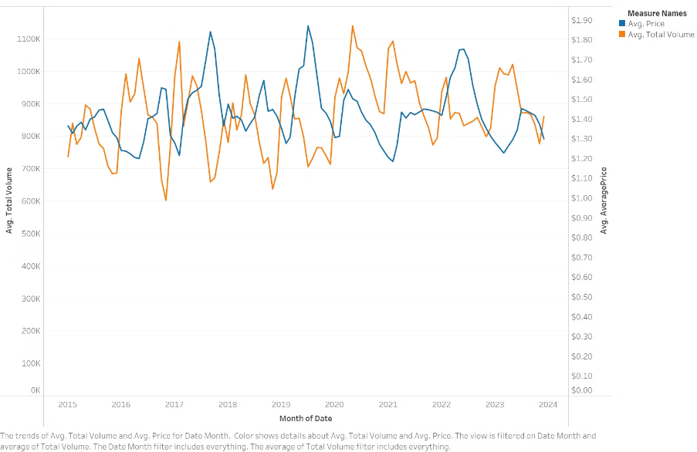
The relation between the Average Price of Avocado and the Average Total Volume sold
The line chart titled "The relation between the Average Price of Avocado and the Average Total Volume sold" has two y-axes, one representing the Average Total Volume sold and the other representing the Average Price in dollars. The x-axis represents the Month of Date. The blue line represents the Average Total Volume sold, and the orange line represents the Average Price of avocados. The chart shows that the price and volume sold are inversely related over time.

Slide 4
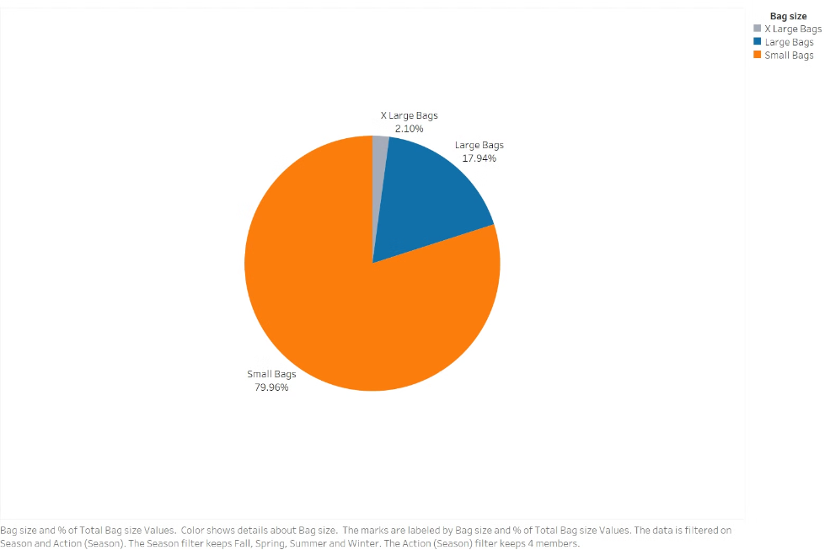
Sales by Package
The "Sales by Bag Size" pie chart shows the sales distribution among Small, Large, and X-Large Bags. Small bags account for 79.98% of sales, Large bags for 17.94%, and X-Large bags for 2.08%. The legend helps identify each bag size category by color.

Slide 5
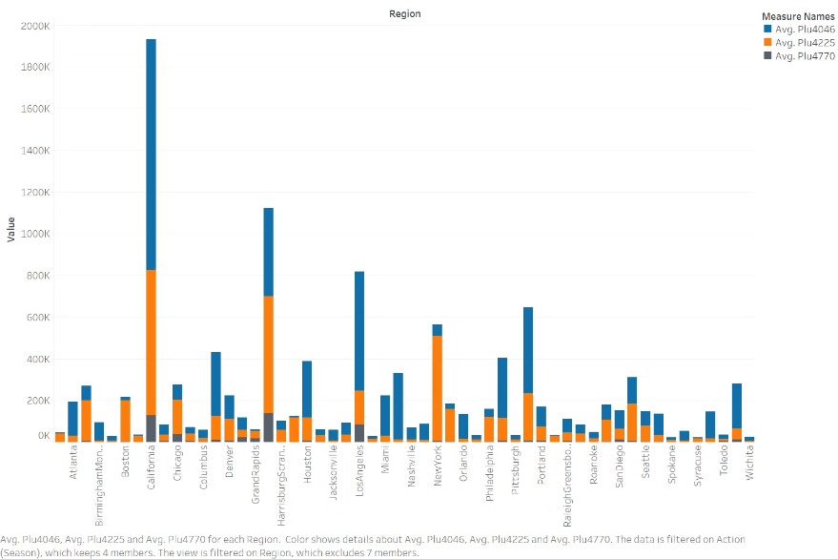
Region-wise sales of different Avocado types
This is a clustered bar chart showing sales of three types of Avocado in different regions. The types are PLU4046 (blue), PLU4225 (orange), and PLU4770 (gray). Each cluster of bars corresponds to a region, with the x-axis showing the regions and y-axis representing sales volume. PLU4046 has the highest sales volume in most regions, followed by PLU4225, and then PLU4770. The legend in the top right corner identifies each type by color, and a note indicates the data is filtered on region, including average sales for each type. Overall, this chart provides a clear comparison of sales volumes across multiple regions, highlighting the dominance of PLU4046.

Slide 6
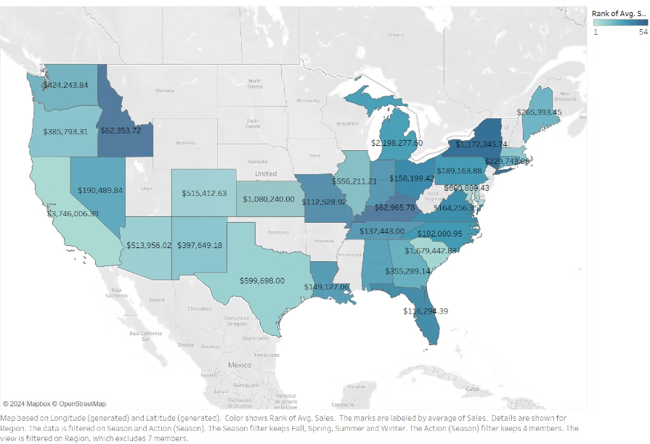
Average Sales by Region
This is a map of the United States, with each state labeled with a numerical value representing the average sales figure. The map is color-coded to display the average sales by region. The West Coast and Northeast show higher averages compared to the Midwest and South regions. Notable sales figures include California, Washington, New York, Texas, Florida, and Illinois. The map appears interactive and serves as a visual tool for comparing average sales across U.S. states.

Slide 7
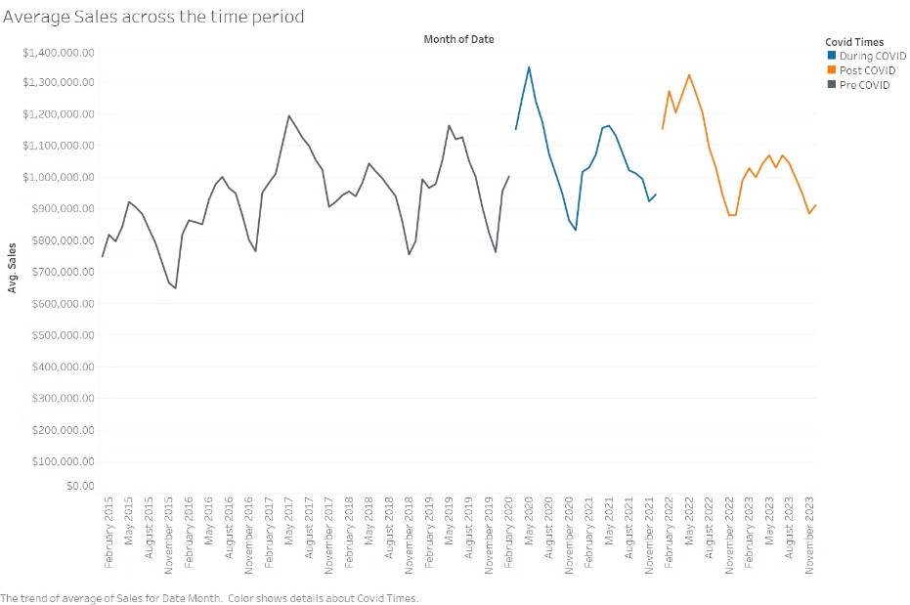
Average Sales across the time period
The chart with three color-coded lines representing pre-COVID, during COVID, and post-COVID sales. The pre-COVID sales trended upward until early 2020, when the COVID-19 pandemic began. During COVID, sales dropped significantly around March 2020, with a sharp dip and recovery, followed by a volatile but generally upward trend. Post-COVID, sales returned to fluctuating patterns but with higher averages than the pre-COVID period. The chart has a legend and a note indicating its purpose of comparing average monthly sales across three different periods with respect to the COVID-19 pandemic.

Slide 8
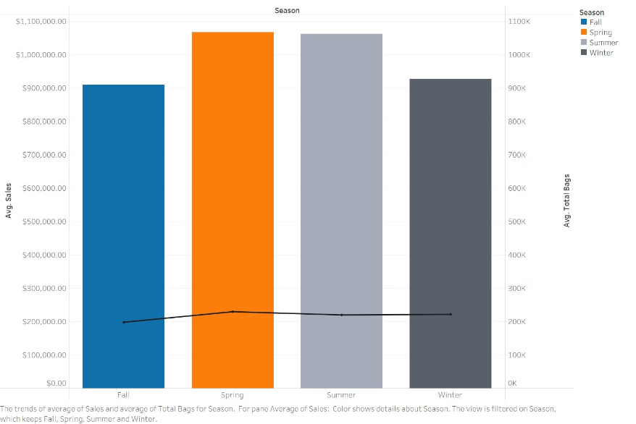
Average sales and Total bags sold according to Seasons
The chart includes a bar chart and a line chart to represent average sales and the total number of bags sold during different seasons. The chart has a horizontal x-axis representing the seasons and two vertical y-axes representing different scales average sales and average total bags sold. The bar chart displays the average sales for each season, while the line chart overlays the bar chart and shows the total number of bags sold. By looking at the bar chart, you can observe that the average sales are highest in Spring, followed by Fall, Summer, and Winter in descending order. From the line chart, we can see that the total number of bags sold is highest in Spring, followed by Summer, Fall, and Winter respectively.

Slide 9
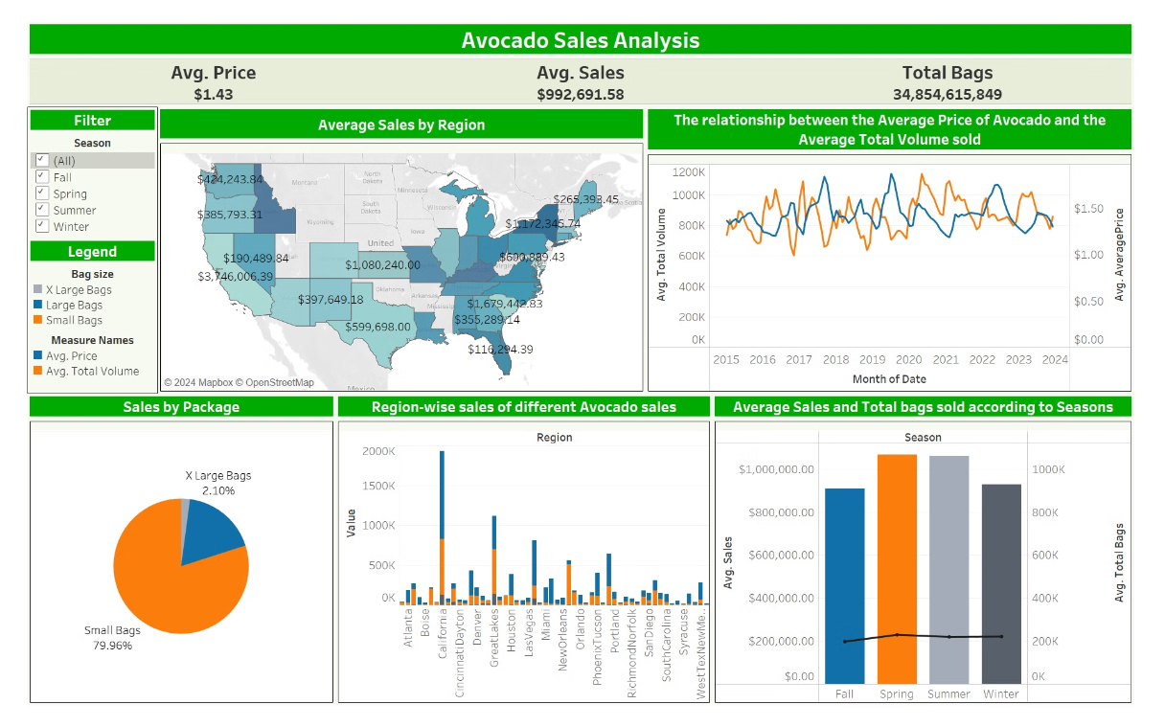
Dashboard

Slide 10
Conclusion and Key Takeaways
1
Avocado Popularity Surge
Avocados have experienced a significant increase in popularity and demand, driven by their health benefits, culinary versatility, and appeal to diverse consumer segments.
2
Evolving Market Dynamics
The sales of large packages are not that successful as compared to smaller packages, a family of four prefers small packages containing 5-6 avocados, rather than large packages with 13-15 avocados.
Avocado sales are directly linked to the population distribution, as we see in the graph the sales are higher in states with high population density, so cities like California, New York, and Los Angeles have very high sales.
3
Opportunities for Growth
The company should consider selling by-products such as oils, sauces, crushes etc, as well, as we don’t see drastic sales increase with a huge difference between years. If the company sets up a farm in the USA, that will benefit more as a large share of avocados are imported into the USA.

Slide 11

Fun Fact
California produces 90% of the U.S. avocado crop. The avocado star of California is San Diego County, which produces 40% of all California-grown avocados.
Thank You

